Slide 1
QAUNTUM
Computers
By Muhammad Hammad Shakeel from BSAI group B

Slide 2
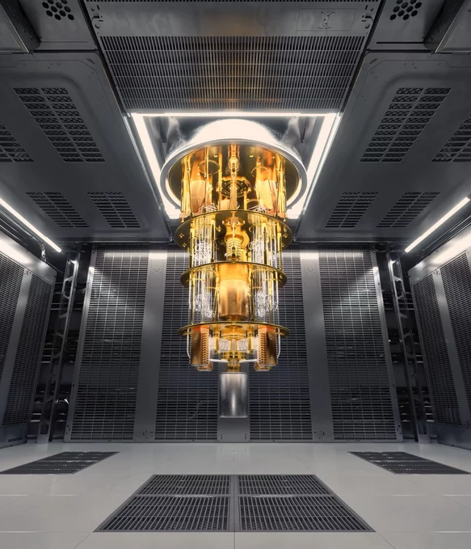
Introduction
Uses
Superposition
Entanglement
Qubits
Quantum Algorithms
Shor’s Algorithm {big numbers}
Grover’s Algorithm {speed}

Slide 3
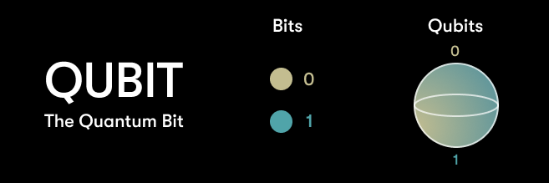

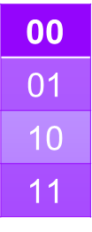

Superposition
A qubit can exist in multiple states simultaneously.
Either it can be 1 or 0 or both simultaneously until measured
$${n=2}^{n}$$
Bit Qubit
00
01
10
11
{01}{01}
00 | 10
01 | 11
{01}0 | 1{01}
{01}1 | 0{01}
0
1
0
1
{01}
==

Slide 4
challenges
Decoherence
Scalability issue; as Qubit increase coherence decreases
Stability and life of Qubit
Making Logic for Quantum Circuits
Todays Technology at 1970s level compared to classical computers
Unreliable , use less bits ,

Slide 5
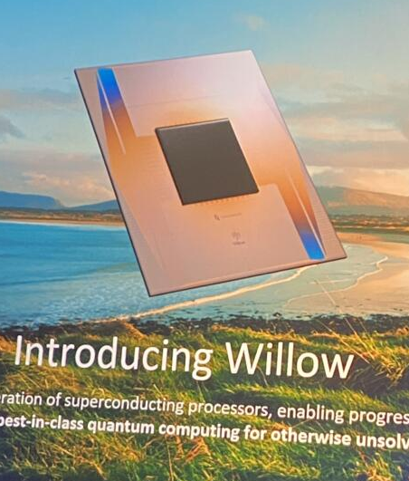
Benefits and solutions
Quantum Algorithms: That makes a Problem solvable by quantum computer.
error-correcting code: to fix error caused due to qubit being fragile beings
RSA 2048-bit encryption that takes our fastest super computer 300 trillion years to decrypt with 1 trillion operations per second speed can be done Quantum computers in 10 seconds with only 1 million operations speed
10 - 20 years warranty
QPU’s instead of GPU’s as they are required to do less operation to get answer
Solved RCS in 10minutes
Takes 10 septillion years by our fastest super computer {10^25)years
Willow can reduce errors “exponentially as the system scales up using more qubits.
“This cracks a challenge in quantum error correction that the field has pursued for almost 30 years,” said Hartmut Neven

Slide 6
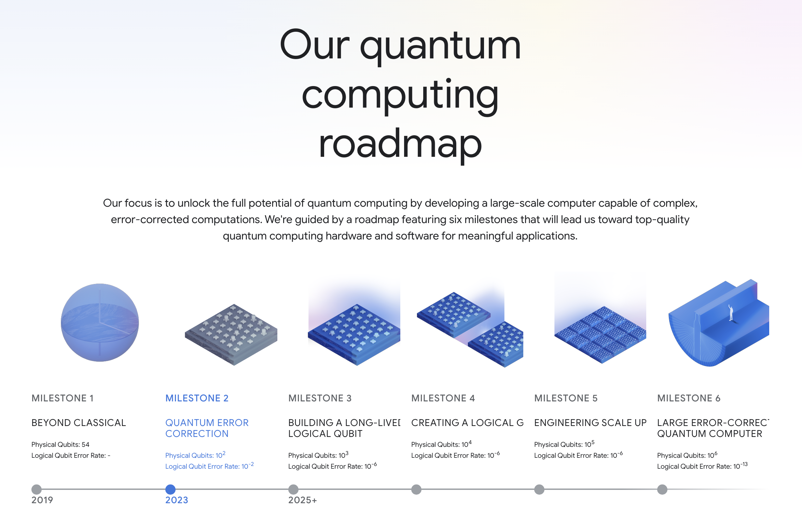

Slide 7
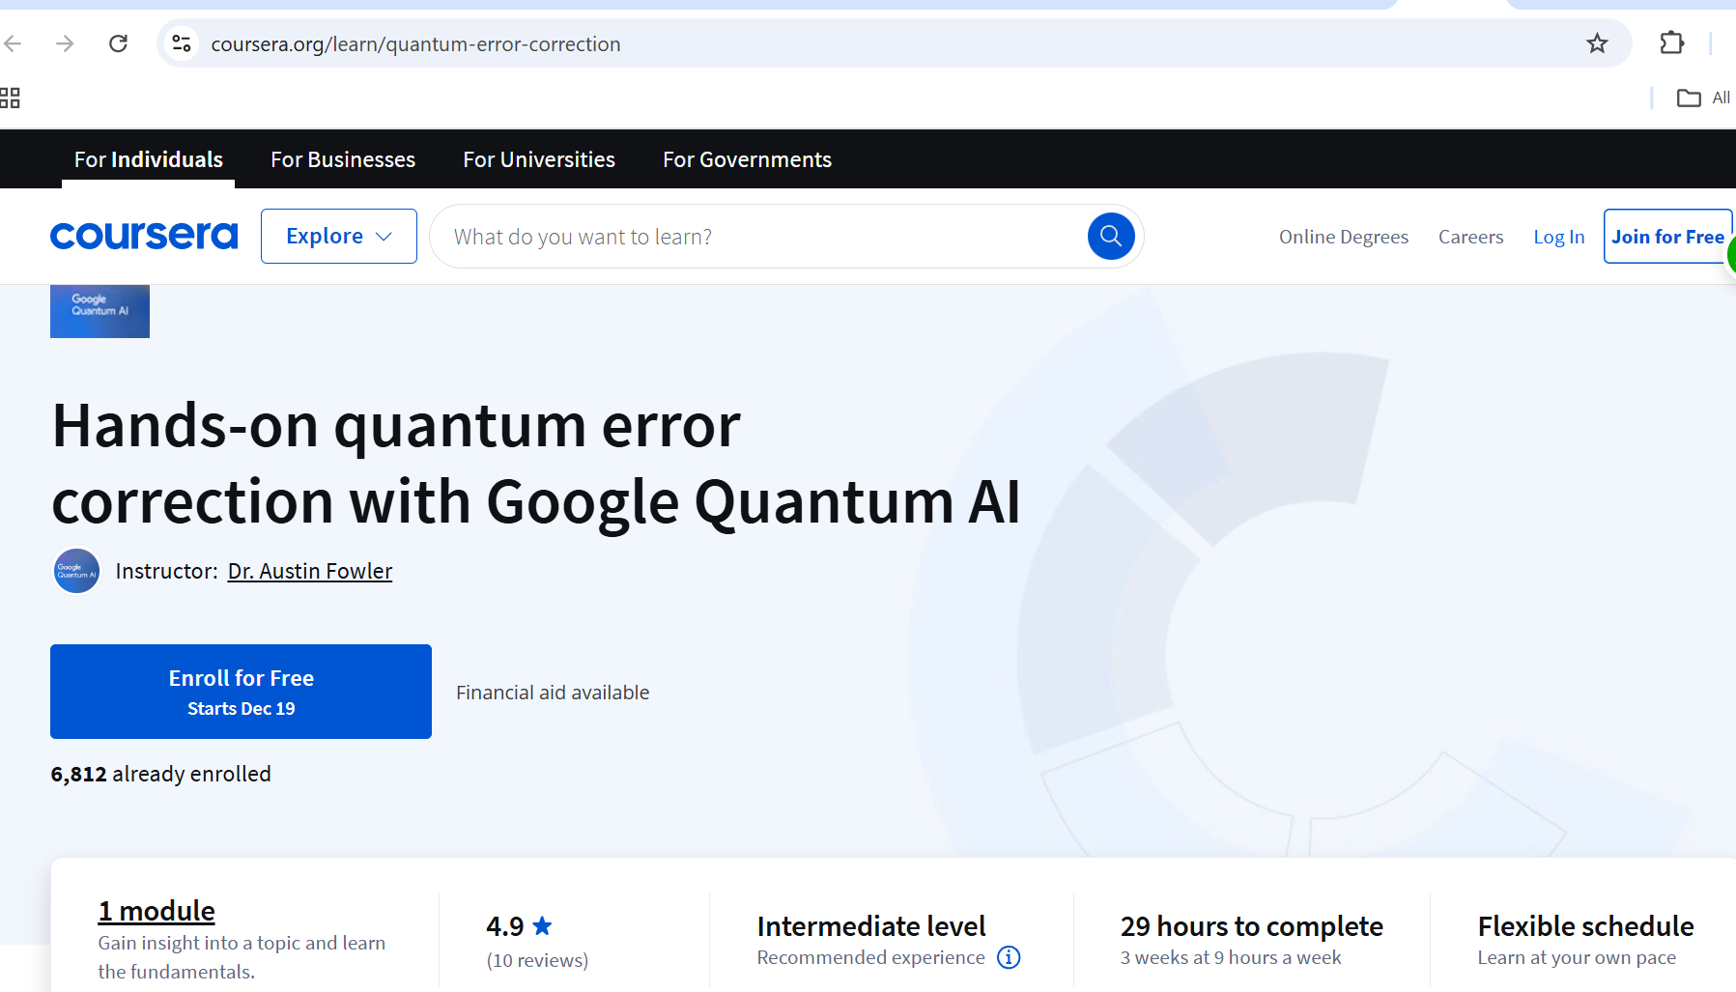
The Power of
Quantum computers

Slide 8
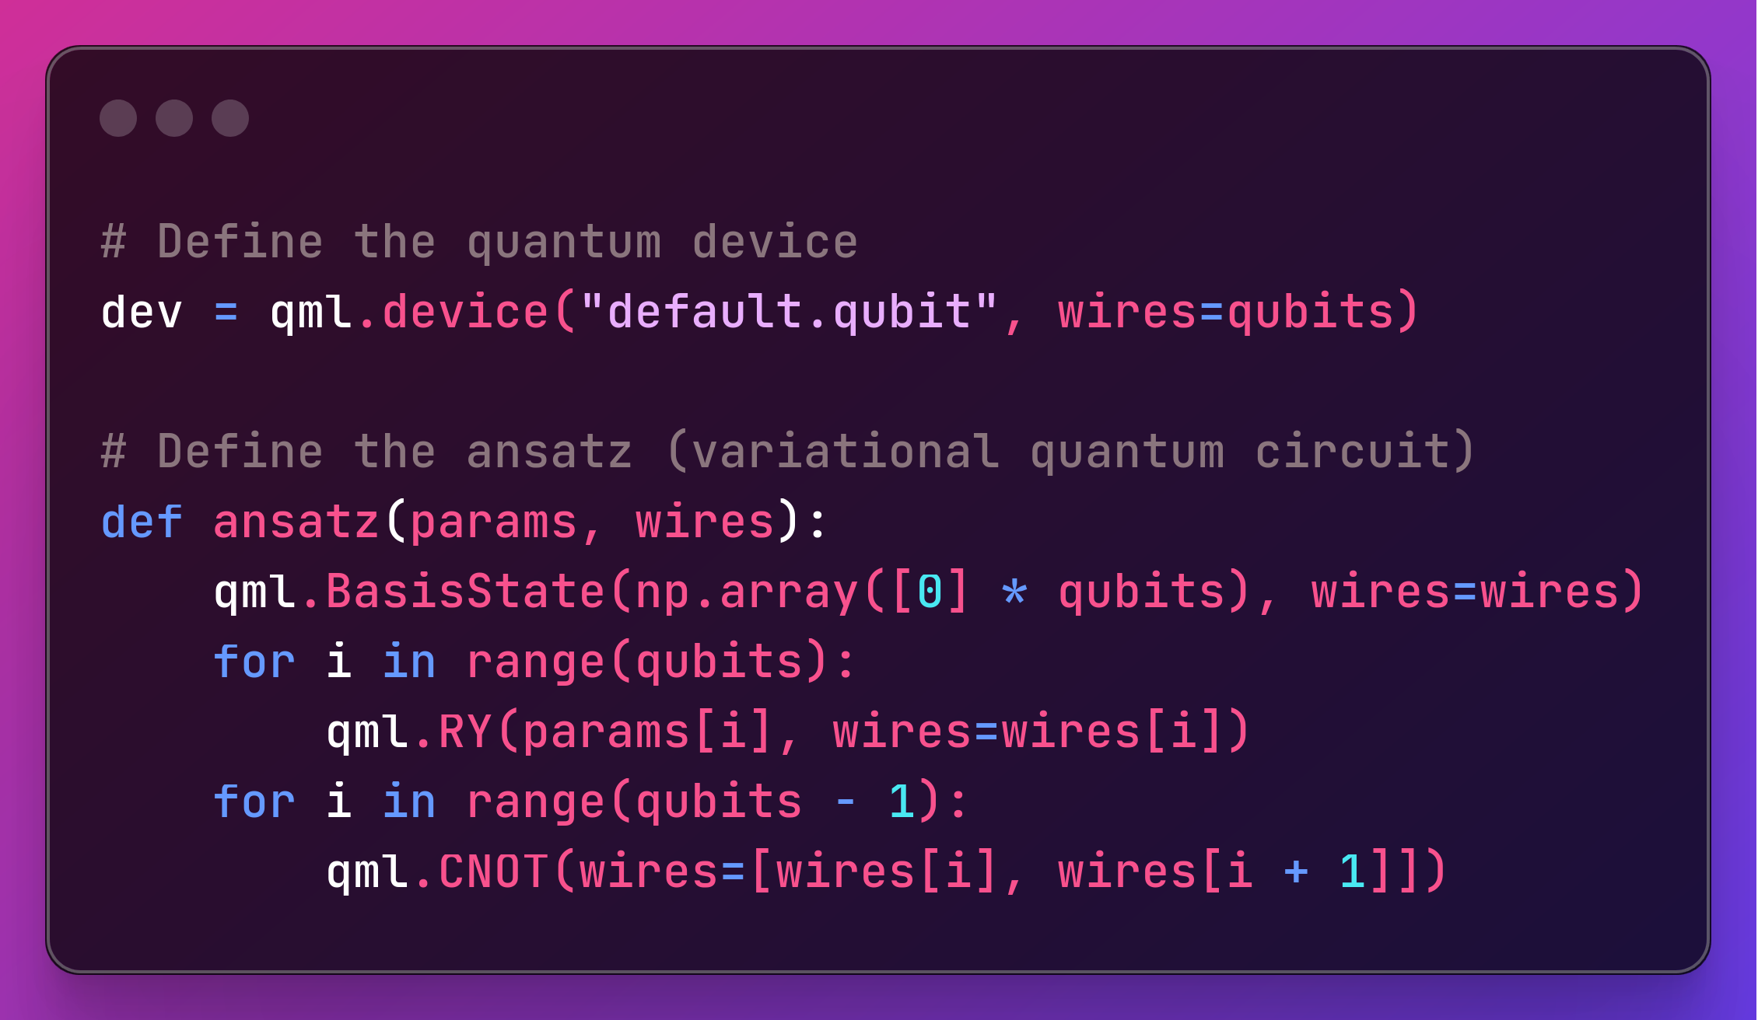

Overcoming
Nervousness

Slide 9
conclusion
What can it do:
Medicine development
Optimizing investment strategies
Image recognition
Quantum Machine Learning (in 6-12 months)
Maybe even Quantum enhanced neural network in 2-3 years

Slide 10

Thank you Everyone
Link link3 link1 link2 2link link4

